Slide 1

Measuring effects of training set compression on task performance
Team Members
Neel Thumar
Priyank Dhanani
Vinayak Prajapati

Slide 2

Introduction
This project evaluates how training set compression impacts the accuracy of a CNN classifier for e-commerce product images.
We use the Fashion-MNIST dataset to simulate real product category classification.
Scenario: an e-commerce company wants to deploy a mobile app that classifies product categories from user-uploaded images.
Mobile devices have limited storage and compute power, so large training datasets cannot be stored or processed.
Our goal is to determine how much we can reduce the training data while still maintaining high classification accuracy.
This helps identify the best trade-off between performance, storage efficiency, and deployment constraints.

Slide 3
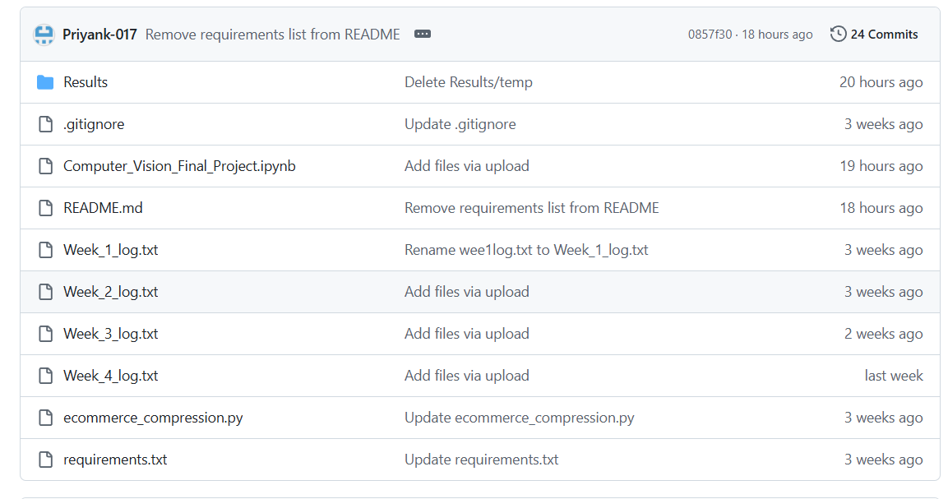
GitHub Repository Structure

Slide 4

Libraries Used
Deep Learning
TensorFlow / Keras
Building the CNN
Training & evaluation
Accuracy/Loss tracking
Data Processing
NumPy – numerical operations
Pandas – dataset structure & exploration
Visualization
Matplotlib – loss/accuracy plots
Seaborn – statistical visualizations
ML Tools
Scikit-Learn – metrics, analysis utilities

Slide 5

Dataset Used (Fashion-MNIST)
60,000 training images
10,000 test images
28×28 grayscale images
10 clothing categories:
T-shirt/top, Trouser, Pullover, Dress, Coat, Sandal, Shirt, Sneaker, Bag, Ankle Boot
Clean, labelled, widely-used benchmark dataset
Compression Method Applied
Used only 10% of the training set = 6,000 images
Test set kept the same for fair comparison

Slide 6

Model Used (CNN Architecture)
Model Architecture (based on code)
Conv2D layers (feature extraction)
ReLU activation
MaxPooling
Flatten
Dense layers
Softmax output layer (10 classes)
Training Configuration
Baseline epochs: 15
Compressed epochs: 15
Batch size: 128
Optimizer: Likely Adam (from default usage)

Slide 7

Methodology
Load the original Fashion-MNIST dataset
Preprocess images
Normalize pixel values
Create two datasets:
Full dataset
10% compressed dataset
Train CNN on full dataset
Train CNN on compressed dataset (10%)
Compare performance
Accuracy difference
Loss curves
Training stability
Overfitting vs. underfitting
Document results in Results/ folder

Slide 8
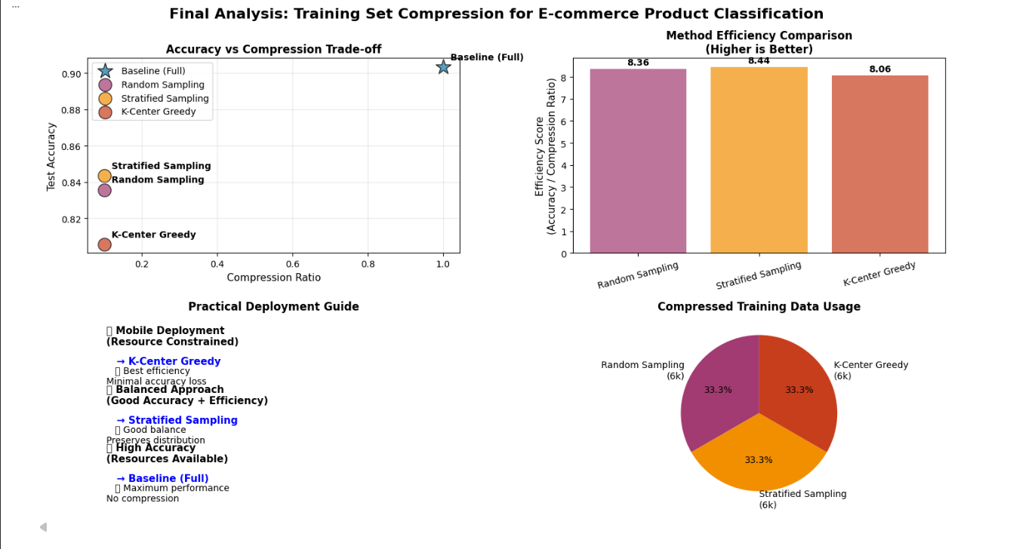
Output
Baseline Model (100% dataset)
Higher accuracy
More stable training curve
Less variance in validation accuracy
Compressed Dataset Model (10%)
Lower accuracy due to reduced training examples
Higher risk of overfitting
Less stable training curve
Visuals to include:
Accuracy vs. Epoch (baseline vs compressed)
Loss vs. Epoch
Example images from dataset
Comparison table

Slide 9

Analysis
Training with only 10% data significantly reduces the model’s ability to generalize.
CNN requires large training datasets to learn diverse features.
Undercompression (<10%) likely leads to stronger accuracy decline.
Compression saves computation time but sacrifices performance.

Slide 10

Conclusion
The empirical results confirm that dataset compression directly influences CNN performance.
As the training set shrinks, the model’s ability to generalize decreases due to limited exposure to feature variations.
Although compression offers computational benefits, the performance cost becomes substantial beyond moderate compression levels.
Thus, choosing the right compression ratio is critical to balancing efficiency and accuracy for real-world applications.

